Slide 1
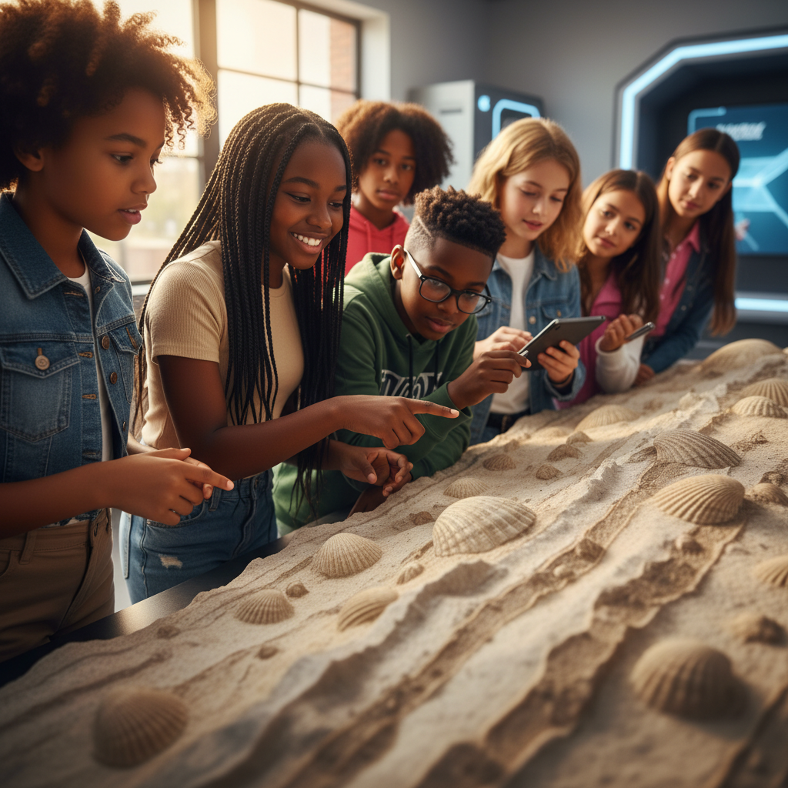
ModelIt!
Student Lesson
The Rock That Remembers Everything
How Earth's Rocks Tell the Story of Millions of Years
NGSS: MS-ESS2-1, MS-ESS2-3
6th Grade
1/9

Slide 2
What You Will Learn Today
Learning Goals
* Explain how heat, pressure, weathering, and time transform one rock type into another
* Model how the rock cycle connects igneous, sedimentary, and metamorphic rocks
* Interpret fossil evidence in sedimentary rock to reconstruct past environments
* Connect the rock cycle to plate tectonics and large-scale Earth processes
Key Vocabulary
Rock Cycle
The continuous process by which rocks are created, broken down, and reformed into different types
Sedimentary Rock
Rock formed from layers of compressed sediment, often containing fossils
Metamorphic Rock
Rock that has been transformed by extreme heat and pressure without melting
Fossil
Preserved remains or traces of ancient organisms found in sedimentary rock layers
2/9

Slide 3
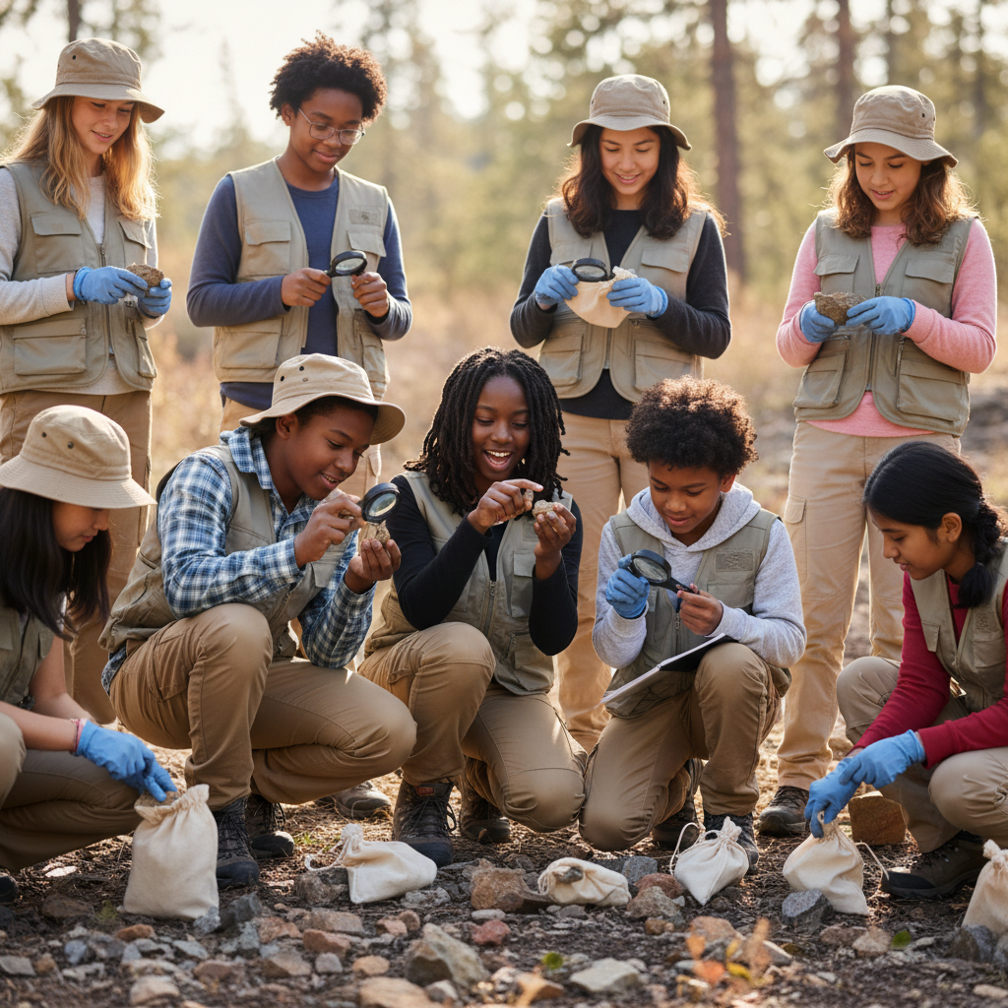
The Big Question
How can a rock on top of a mountain contain seashells from the bottom of an ancient ocean?
How Earth's Rocks Tell the Story of Millions of Years. Today we'll build a MODEL to discover the answer!
3/9

Slide 4

Today We Will Build a Model!
A model helps us understand complex systems!
1. LOCATE
Identify the COMPONENTS (parts) of the system
2. ESTABLISH
Connect them with RELATIONSHIPS (+ or -)
3. VISUALIZE
Build your model in ModelIt!
4. EVALUATE
Run SIMULATIONS to test scenarios
5. REVISE
Improve your model based on evidence
4/9

Slide 5

Activity 1: Sort the Components
Sort these components into EXTERNAL (inputs from outside) and INTERNAL (inside the system):
Your Components:
* Heat & Pressure
* Weathering Rate
* Sediment Layers
* Time
Think: Which components can we control? Which happen on their own?
5/9

Slide 6
Activity 2: Connect with Arrows
Draw arrows to show HOW components affect each other:
(+) POSITIVE Relationship
When one goes UP, the other goes UP too
(-) NEGATIVE Relationship
When one goes UP, the other goes DOWN
Think About It:
When heat and pressure increase, what type of rock forms? When weathering rate increases, what happens to sediment layers?
6/9

Slide 7
Activity 3: Run the Simulation!
Test these scenarios in ModelIt!
Mountain Builder
Set Heat & Pressure to maximum and observe rock transformation over millions of years
Erosion Machine
Lock Weathering Rate to maximum and watch sediment layers build up
Deep Time
Set all processes to moderate and observe the full rock cycle over 500 million years
Watch the activity graphs change!
[ModelIt Platform Screenshot - Simulation Results Graph]
7/9

Slide 8
What Did We Discover?
Our Model Showed Us:
* The same atoms that make up a rock today have been recycled through the rock cycle for billions of years
* Extreme heat and pressure transform sedimentary rock into metamorphic rock without melting it
* Fossils are only preserved in sedimentary rock because igneous and metamorphic processes destroy them
* The rock cycle is powered by TWO energy sources: Earth's internal heat and the Sun's energy (driving weathering)
Answer: Seashells end up on mountaintops because sedimentary rock forms on ocean floors where shells accumulate in layers. Over millions of years, tectonic forces push that seafloor upward, and heat and pressure can transform it. The rock 'remembers' its ocean origins through the fossils trapped inside — a record of millions of years of Earth's history!
8/9

Slide 9

STEM Challenge: Design a Geological Time Capsule
YOUR ENGINEERING MISSION
Design a system to preserve a message for 1 million years using your understanding of how rocks form, weather, and preserve materials.
The Challenge:
A science foundation wants to create a time capsule that will survive for 1 million years. Your geology team must use evidence from the rock cycle model to recommend the best materials, location, and protection strategy.
Think Like an Engineer:
* Which rock type is most likely to preserve your message for a million years?
* What location would protect your time capsule from weathering and tectonic destruction?
* How does understanding the rock cycle help you predict what might happen to your capsule?
REAL CAREER CONNECTION: Geologists and Paleontologists study rocks, fossils, and Earth's history to find natural resources, predict hazards, and understand our planet's past. They earn $60,000–$115,000/year. The skills you're using TODAY are the same ones they use on the job!
9/9

